Slide 1
Introduction to Single-cell RNA-Seq

Slide 2
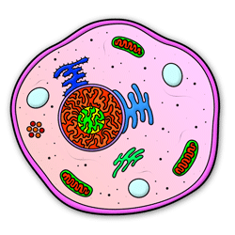

RNA-Seq
Overview

Slide 3

RNA-Seq
Overview

Slide 4


RNA-Seq
Overview
>_
read_alignment
quantification
Population
Average
tx1
tx2
tx3

Slide 5
RNA-Seq | From bulk to single-cell measurements
Overview
Population
Average
tx1
tx2
tx3
Limitations of bulk measurements

Slide 6
RNA-Seq | From bulk to single-cell measurements
Overview
Population
Average
tx1
tx2
tx3
Limitations of bulk measurements
control
treatment
tx1
tx2
tx3

Slide 7
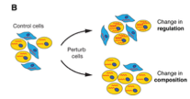
RNA-Seq | From bulk to single-cell measurements
Overview
Population
Average
tx1
tx2
tx3
Limitations of bulk measurements
control
treatment
?
tx1
tx2
tx3

Slide 8

RNA-Seq | From bulk to single-cell measurements
Overview
Population
Average
tx1
tx2
tx3
Limitations of bulk measurements

Slide 9
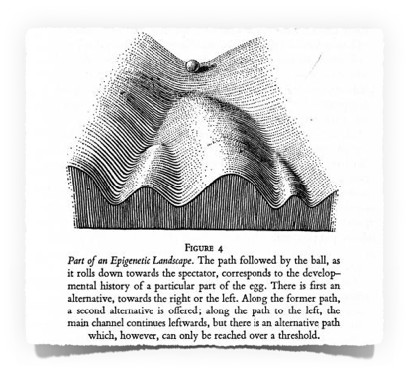
RNA-Seq | From bulk to single-cell measurements
Overview
Population
Average
tx1
tx2
tx3
Limitations of bulk measurements
C. H. Waddington, “The Strategy of the Genes” (1957)

Slide 10
RNA-Seq | From bulk to single-cell measurements
Overview
Population
Average
tx1
tx2
tx3
Limitations of bulk measurements
C. H. Waddington, “The Strategy of the Genes” (1957)

Slide 11
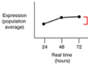
RNA-Seq | From bulk to single-cell measurements
Overview
Population
Average
tx1
tx2
tx3
Limitations of bulk measurements

Slide 12
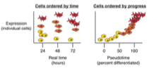
RNA-Seq | From bulk to single-cell measurements
Overview
Population
Average
tx1
tx2
tx3
Limitations of bulk measurements

Slide 13
RNA-Seq | From bulk to single-cell measurements
Overview
Population
Average
tx1
tx2
tx3
Limitations of bulk measurements
Cells ordered by progress
Pseudotime
(percent differentiated)

Slide 14
RNA-Seq | From bulk to single-cell measurements
Overview
Population
Average
tx1
tx2
tx3
Single-Cell RNA-Seq (Tang et al. 2009)

Slide 15
RNA-Seq | From bulk to single-cell measurements
Overview
Population
Average
tx1
tx2
tx3
Single-Cell RNA-Seq (Tang et al. 2009)
one cell

Slide 16
RNA-Seq | From bulk to single-cell measurements
Overview
Population
Average
tx1
tx2
tx3
Single-Cell RNA-Seq (Tang et al. 2009)
chemistry challenge: small amount of starting material
one cell

Slide 17
RNA-Seq | From bulk to single-cell measurements
Overview
Population
Average
tx1
tx2
tx3
Single-Cell RNA-Seq (Tang et al. 2009)
chemistry challenge: small amount of starting material
Individual
Cell
tx1
tx2
tx3
one cell

Slide 18
RNA-Seq | From bulk to single-cell measurements
Overview
Population
Average
tx1
tx2
tx3
Single-Cell RNA-Seq (Tang et al. 2009)
chemistry challenge: small amount of starting material
Individual
Cell
tx1
tx2
tx3
one cell
one cell is (obviously) not enough
population density
bulk
x
transcript_1 abundance

Slide 19
RNA-Seq | From bulk to single-cell measurements
Overview
Population
Average
tx1
tx2
tx3
Single-Cell RNA-Seq (Tang et al. 2009)
chemistry challenge: small amount of starting material
Individual
Cell
tx1
tx2
tx3
one cell
one cell is (obviously) not enough
population density
cell
bulk
x
x
transcript_1 abundance

Slide 20
RNA-Seq | From bulk to single-cell measurements
Overview
Population
Average
tx1
tx2
tx3
Single-Cell RNA-Seq (Tang et al. 2009)
chemistry challenge: small amount of starting material
Individual
Cell
tx1
tx2
tx3
one cell
one cell is (obviously) not enough
population density
cell
bulk
cell
x
x
x
transcript_1 abundance

Slide 21
RNA-Seq | From bulk to single-cell measurements
Overview
Population
Average
tx1
tx2
tx3
Single-Cell RNA-Seq (Tang et al. 2009)
chemistry challenge: small amount of starting material
Individual
Cell
tx1
tx2
tx3
one cell
one cell is (obviously) not enough
population density
cell
bulk
cell
cell
x
x
x
x
transcript_1 abundance

Slide 22
RNA-Seq | From bulk to single-cell measurements
Overview
Population
Average
tx1
tx2
tx3
Single-Cell RNA-Seq (Tang et al. 2009)
chemistry challenge: small amount of starting material
Individual
Cell
tx1
tx2
tx3
one cell
one cell is (obviously) not enough
population density
time consuming
very high cost per cell
cell
bulk
cell
cell
x
x
x
x
transcript_1 abundance

Slide 23
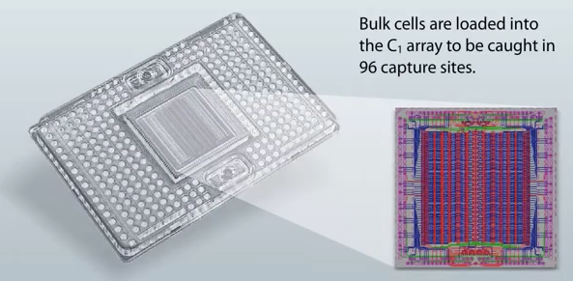
Single Cell RNA-Seq | Microfluidics
Parallelize and automate single cell processing (Fluidigm C1)
— Improved chemistry: SMART-Seq (Ramsköld et al., 2012)

Slide 24
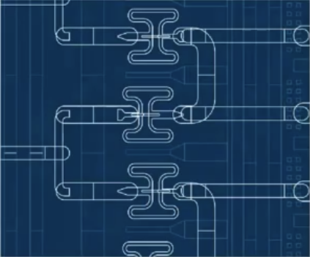
Single Cell RNA-Seq | Microfluidics
Parallelize and automate single cell processing (Fluidigm C1)
— Improved chemistry: SMART-Seq (Ramsköld et al., 2012)
Cells

Slide 25
Single Cell RNA-Seq | Microfluidics
Parallelize and automate single cell processing (Fluidigm C1)
— Improved chemistry: SMART-Seq (Ramsköld et al., 2012)
Cells

Slide 26
Single Cell RNA-Seq | Microfluidics
Parallelize and automate single cell processing (Fluidigm C1)
— Improved chemistry: SMART-Seq (Ramsköld et al., 2012)
single cell cDNA
single cell cDNA
single cell cDNA
Cells

Slide 27
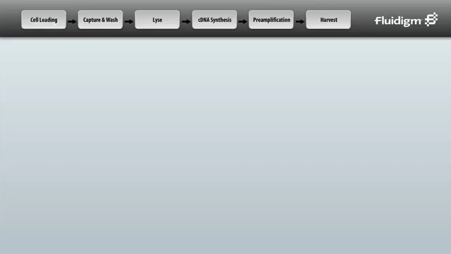
Single Cell RNA-Seq | Microfluidics
Parallelize and automate single cell processing (Fluidigm C1)
— Improved chemistry: SMART-Seq (Ramsköld et al., 2012)

Slide 28
Single Cell RNA-Seq | Droplet microfluidics
Drop-Seq (Makosko et al., 2015)
InDrop (Klein et al., 2015)
Scale up number of cells (capture cells inside nanoliter droplets) — key ingredients: cell Ldes and unique molecular identifiers (UMIs)
[Islam et al., 2012]

Slide 29
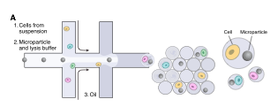
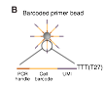
Single Cell RNA-Seq | Droplet microfluidics
Drop-Seq (Makosko et al., 2015)
InDrop (Klein et al., 2015)
Scale up number of cells (capture cells inside nanoliter droplets) — key ingredients: cell barcodes and unique molecular identifiers (UMIs)
[Islam et al., 2012]
cells
Oil
cell
barcoded bead
droplets
barcoded
beads
droplets
Drop-Seq
cells
Oil

Slide 30
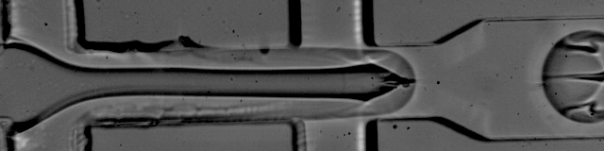
Single Cell RNA-Seq | Droplet microfluidics
Drop-Seq (Makosko et al., 2015)
InDrop (Klein et al., 2015)
Scale up number of cells (capture cells inside nanoliter droplets) — key ingredients: cell barcodes and unique molecular identifiers (UMIs)
[Islam et al., 2012]
cells
Oil
cell
barcoded
beads
droplets
cells
Oil

Slide 31
Single Cell RNA-Seq | Droplet microfluidics
Drop-Seq (Makosko et al., 2015)
InDrop (Klein et al., 2015)
Scale up number of cells (capture cells inside nanoliter droplets) — key ingredients: cell barcodes and unique molecular identifiers (UMIs)
[Islam et al., 2012]
cells
Oil
cell
barcoded bead
barcoded
beads
droplets
cells
Oil

Slide 32
Single Cell RNA-Seq | Droplet microfluidics
Drop-Seq (Makosko et al., 2015)
InDrop (Klein et al., 2015)
Scale up number of cells (capture cells inside nanoliter droplets) — key ingredients: cell barcodes and unique molecular identifiers (UMIs)
[Islam et al., 2012]
cells
Oil
cell
barcoded bead
barcoded
beads
droplets
cells
Oil

Slide 33
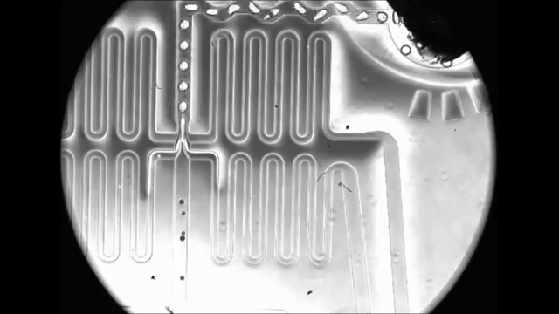
Single Cell RNA-Seq | Droplet microfluidics
Oil
Oil
Cells
Cells
barcodes

Slide 34
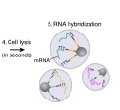
Single Cell RNA-Seq | Droplet microfluidics
cell
barcoded bead
droplets

Slide 35
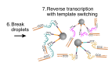
Single Cell RNA-Seq | Droplet microfluidics
cell
barcoded bead
droplets

Slide 36
Single Cell RNA-Seq | Droplet microfluidics
cell
barcoded bead
droplets
Reverse
transcription
PCR
Sequencing
(joint downstream processing)

Slide 37
Single Cell RNA-Seq | Droplet microfluidics
cell
barcoded bead
droplets
Reverse
transcription
PCR
Sequencing
(joint downstream processing)

Slide 38
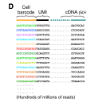
Single Cell RNA-Seq | Droplet microfluidics
Sequencing:
cDNA from transcript

Slide 39
Single Cell RNA-Seq | Droplet microfluidics
Sequencing:
cDNA from transcript
Paired-end reads
(3’end-bias)
R1
R2
R1
R2
R1
R2
R1
R2
R1
R2
R1
R2
R1
R2
R1
R2
R1
R2
R1
R2

Slide 40
Single Cell RNA-Seq | Droplet microfluidics
Sequencing:
Paired-end reads
(3’end-bias)

Slide 41
Drop-Seq | Computational Workflow
Goal:
Trace reads back to individual cells
cell
barcoded bead

Slide 42
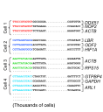
Drop-Seq | Computational Workflow
Goal:
Trace reads back to individual cells
cell
barcoded bead
1. Group by cell barcode

Slide 43
Drop-Seq | Computational Workflow
Goal:
Trace reads back to individual cells
cell
barcoded bead
1. Group by cell barcode
2. Align cDNA reads (transcript identity)

Slide 44
Drop-Seq | Computational Workflow
Goal:
Trace reads back to individual cells
1
1
1
cell
barcoded bead
1
1
1
2
1
1
1
2
1. Group by cell barcode
2. Align cDNA reads (transcript identity)
3. Count reads per cell per gene

Slide 45
Drop-Seq | Computational Workflow
Goal:
Trace reads back to individual cells
1
1
1
cell
barcoded bead
1
1
1
2
1
1
1
2
1. Group by cell barcode
2. Align cDNA reads (transcript identity)
unique molecules
3. Count reads per cell per gene

Slide 46
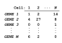
Drop-Seq | Computational Workflow
Final output
gene expression matrix

Slide 47
Drop-Seq | Computational Workflow
Final output
gene expression matrix
What can go wrong?

Slide 48
Drop-Seq | Sources of error
errors in barcodes (sequencing + synthesis)
barcode detection and error correction
errors in cell encapsulation (cell doublets)
doublet identification / filtering

Slide 49
Drop-Seq | Sources of error
errors in cell encapsulation (cell doublets)
empty
multiplets
Probability
empty
singlets
Probability
singlets
multiplets
Poisson rate (λ)
Poisson rate (λ)

Slide 50
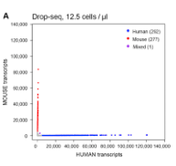
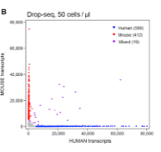
Drop-Seq | Sources of error
Human-mouse experiment
1,250 cells/h
5,000 cells/h

Slide 51
Single Cell RNA-Seq | Perspective

Slide 52
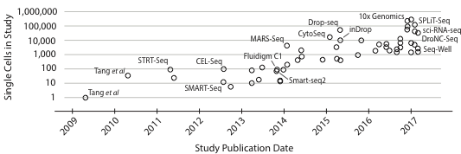
Single Cell RNA-Seq | Perspective

Slide 53
Single Cell RNA-Seq | Perspective
1.3 million cell datasets already here

Slide 54
Single Cell RNA-Seq | Perspective
1.3 million cell datasets already here
Sequencing cost is becoming the bottleneck
current cost ~ $0.00001 per read

Slide 55
Single Cell RNA-Seq | Perspective
1.3 million cell datasets already here
Sequencing cost is becoming the bottleneck
current cost ~ $0.00001 per read
1M cells @ 50K reads/cell ~ 50 billion reads
cost ~ $500K

Slide 56

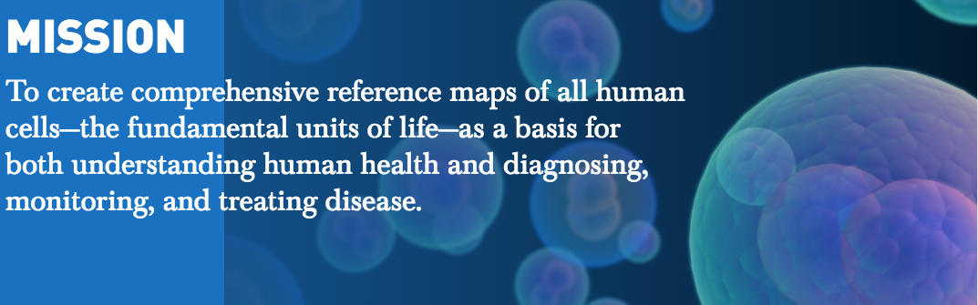
Single Cell RNA-Seq | Perspective
Ongoing global effort
How many different types of cells are in our bodies?

Slide 57
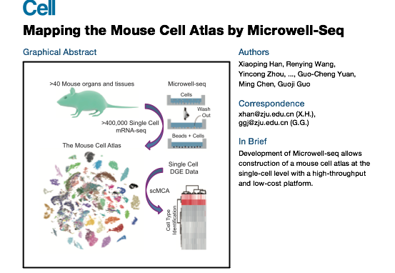
Single Cell RNA-Seq | Perspective
Very recently… (mini) mouse atlas
(Cell, Feb 22, 2018)

Slide 58
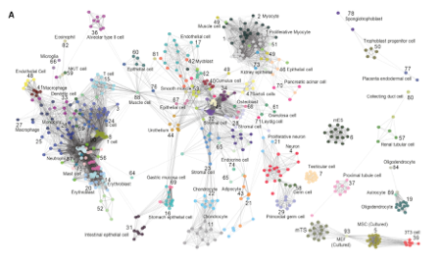
Single Cell RNA-Seq

